Slide 1
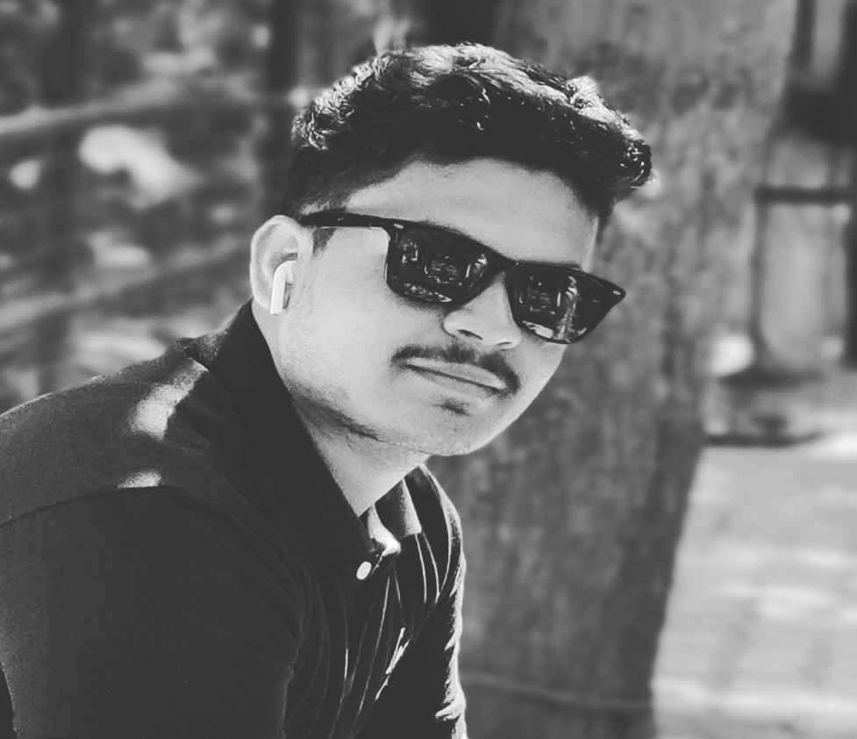
Nouman Ahmed 3rd year, Electrical & Electronics Engineering, Vidyavardhaka College of Engineering(VVCE), Mysore, Karnataka - 570019.

Slide 2
Smart Agriculture System
Based on IoT
Online Internship at:
SmartInternz
Developed By: Nouman Ahmed
Project ID : SPS_PRO_101
SmartBridge
IoT Application Developer

Slide 3
PROJECT DESCRIPTION
Smart Agriculture System based on IoT can monitor soil moisture and climatic conditions to grow and yield a good crop.
The farmer can also get the realtime weather forecasting data by using external platforms like Open Weather API.
Farmer is provided a mobile app using which he can monitor the temperature,humidity and soil moisture parameters along with weather forecasting details.
Based on all the parameters he can water his crop by controlling the motors using the mobile application.
Even if the farmer is not present near his crop he can water his crop by controlling the motors using the mobile application from anywhere.
Here we are using the Online IoT simulator i.e Watson IoT Sensor Simulator for getting the Temperature,Humidity and Soil Moisture values.

Slide 4
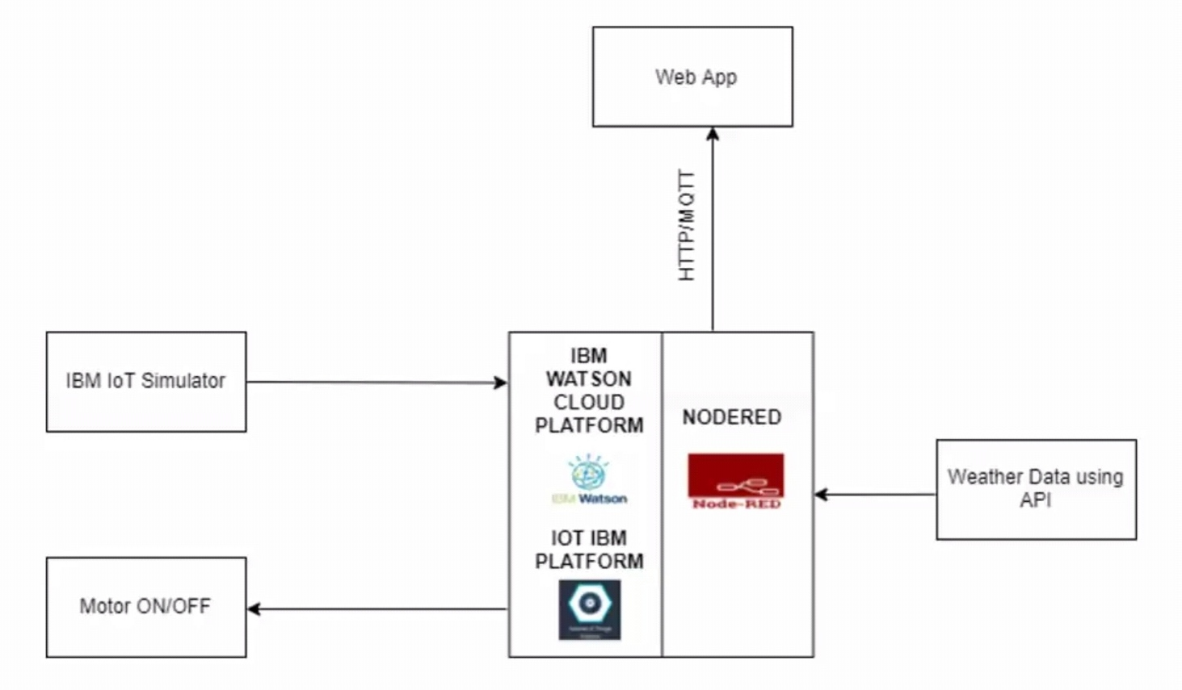
BLOCK DIAGRAM

Slide 5
FUTURE SCOPE
The smart agriculture system can help farmers to save electricity and water consumption as it allows farmers to control their water motor through their web app.
If they get accurate weather conditions of their field , they can critically analyse the needs of their crop and accordingly fulfil it, leading to increased crop yield hence increasing their profit.
IoT sensors are capable of providing farmers with information about crop yields, rainfall, pest infestation, and soil nutrition are invaluable to production and offer precise data which can be used to improve farming techniques over time.

